Slide 1


Player 1 : Ajay 058
Player 2 : Abhiram 001
Player 3 : Ganesh 012

Slide 2
Basic features of the project
User:
Enters their respective info
Round 1
Round 2 (if the user passes round 1)
Round 3 (if the user passes round 2)
Display the results

Slide 3
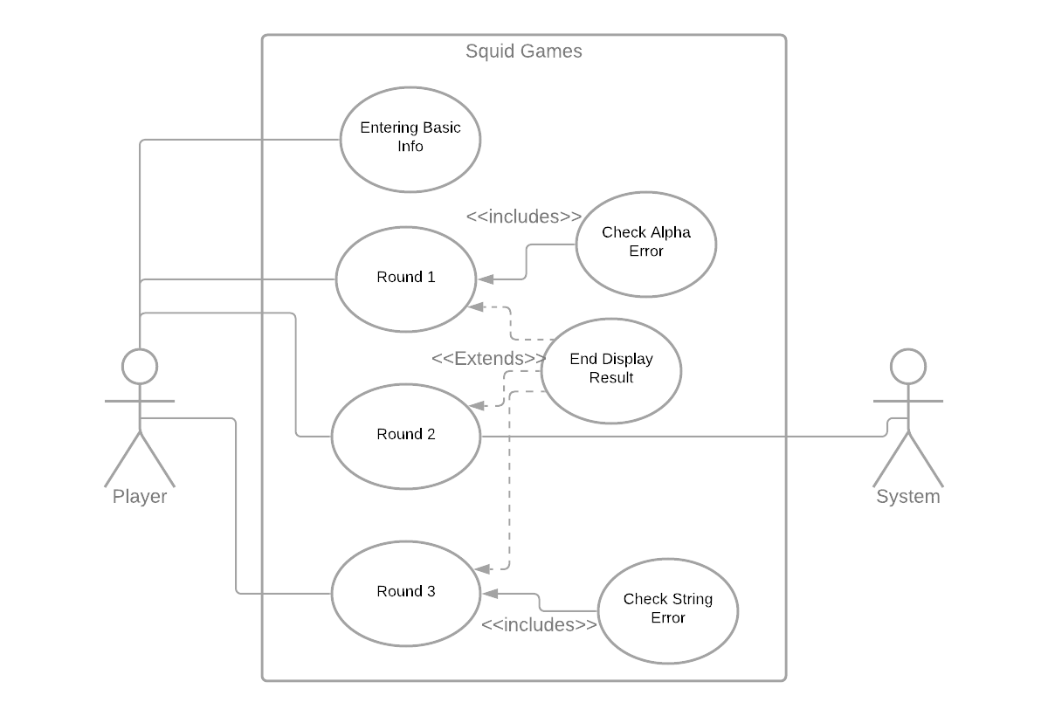
Use Case Diagram

Slide 4
Entering their respective info
Actors: User
Description: Allows the user to create their identity for the game
Main flow:
User | System
1. Enters their credentials
 | 2. Creates a space for the user if new otherwise the old data will be overridden if the new score exceeds the old one
3. The user can then begin the game

Slide 5
Round 1
Actors: User
Description: The Hangman game
Pre- conditions: None
Post- conditions: Proceeds to round 2 if he wins this round otherwise the game ends
Main flow:
User | System
1. Begins the game by typing a letter
 | 2. Displays all the positions of the letter is present otherwise the hangman starts getting displayed part by part
3. This loop continues until the user guesses the word within the given limit

Slide 6
Round 2
Actors: User
Description: The Confusion game
Pre- conditions: Must win round 1
Post- conditions: Proceeds to round 3 if he wins this round otherwise the game ends
Main flow:
User | System
1. Begins the game by typing a word
 | 2. The system responds by typing the same word with a new word and the screen vanishes after certain time
3. This loop continues until the limit is reached, if the user enters a wrong word or messes with the order, he/she loses

Slide 7
Round 3
Actors: User
Description: 4 pics 1 word
Pre- conditions: Must win round 1
Post- conditions: Proceeds to round 3 if he wins this round otherwise the game ends
Main flow:
User | System
1. The user must guess the word with the provided 4 images, in a limited number of chances
 | 2. If the user enters the correct word, the next set of pictures show up. If not, then the system reveals one letter
3. This loop continues until a certain number of words are guessed. The user wins the game if round 3 is completed successfully.

Slide 8
Displaying the result
Actors: User
Description: Displays the number of points the user scored
Pre- conditions: Must complete any round( win or lose)
Post- conditions: None
Main flow:
User | System
1. Completes any round
 | 2. Computes the points of the user based on the performance
 | 3. Displays the overall result and stores it in a database for future use

Slide 9
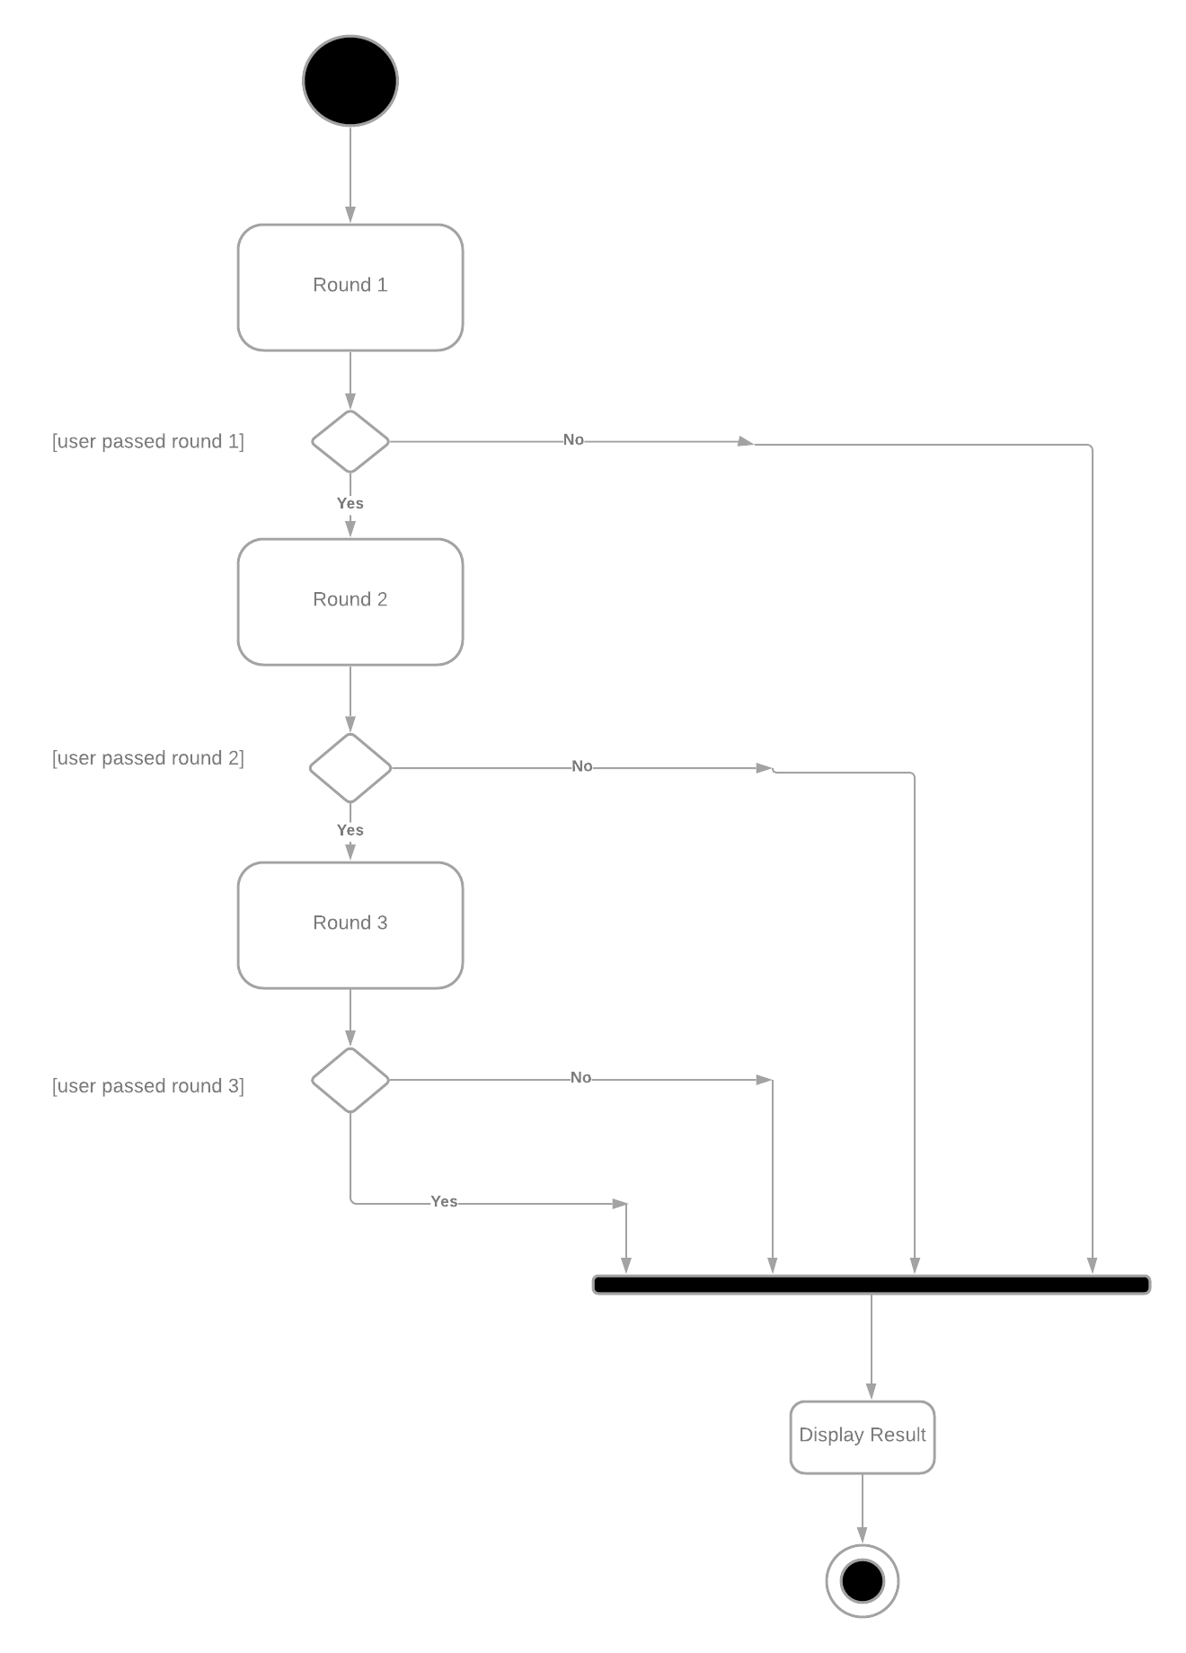
Activity diagram
Our program majorly implements the use of GUI (Graphical User Interface). The logic and the path of the program is pretty straight forward but we are making it look attractive and intuitive.

Slide 10


